Slide 1

Case 3: Zanzare Constrcutions
Source: A guide to construction safety for homebuilders

Slide 2
Content
Introductory Part: Short report
Problems
1st Solution: Motivation suggestions
2nd Solution: Leadership style
3rd Solution: Personality theories
4th Solution: Organizational structure
Concluding Part
Reference

Slide 3

Introduction
Short case description
Zanzare Constructions is a foreign company with 170 people of human resource capital. The company carries out geological intelligence, building design, calculation of required materials, risks, time scale and etc.
Source: BIMCommunity, 2018

Slide 4
Problems
1st Problem: Conflict among employees
2nd Problem: No motivation to work as a team
3rd Problem: Failure in project completion
4th Problem: Difficulty in evaluating performance

Slide 5
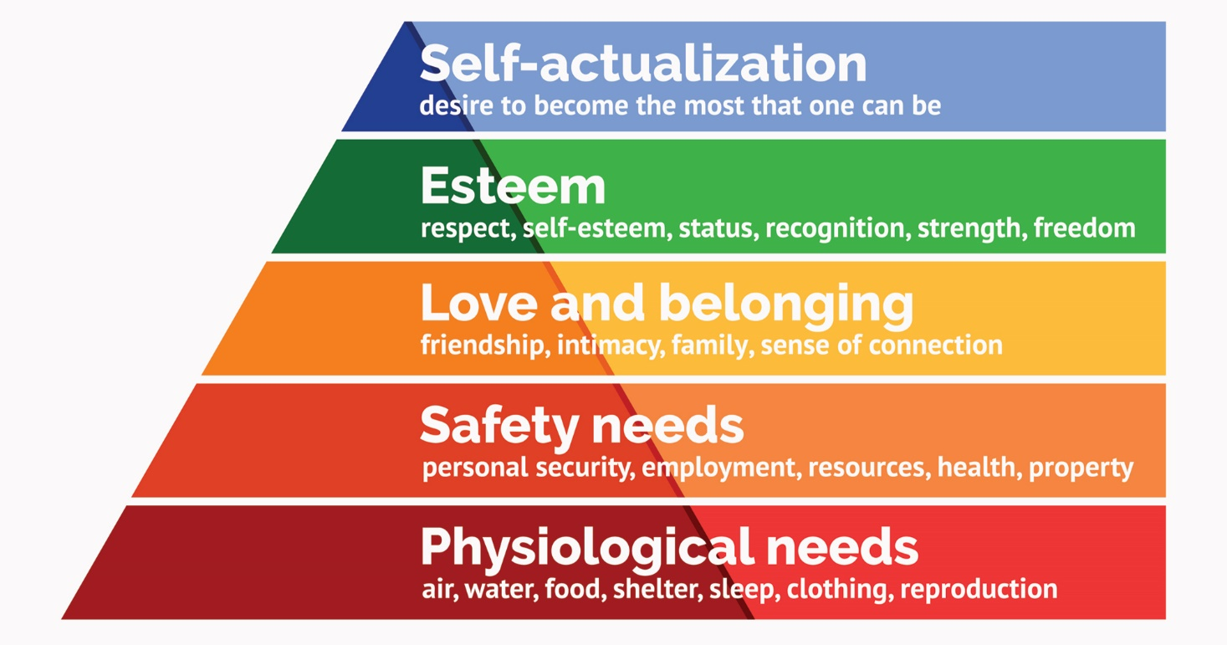
1st Solution: Motivation Suggestions
Maslow’s Hierarchy of Needs
Source: Saul McLeod, 2020

Slide 6
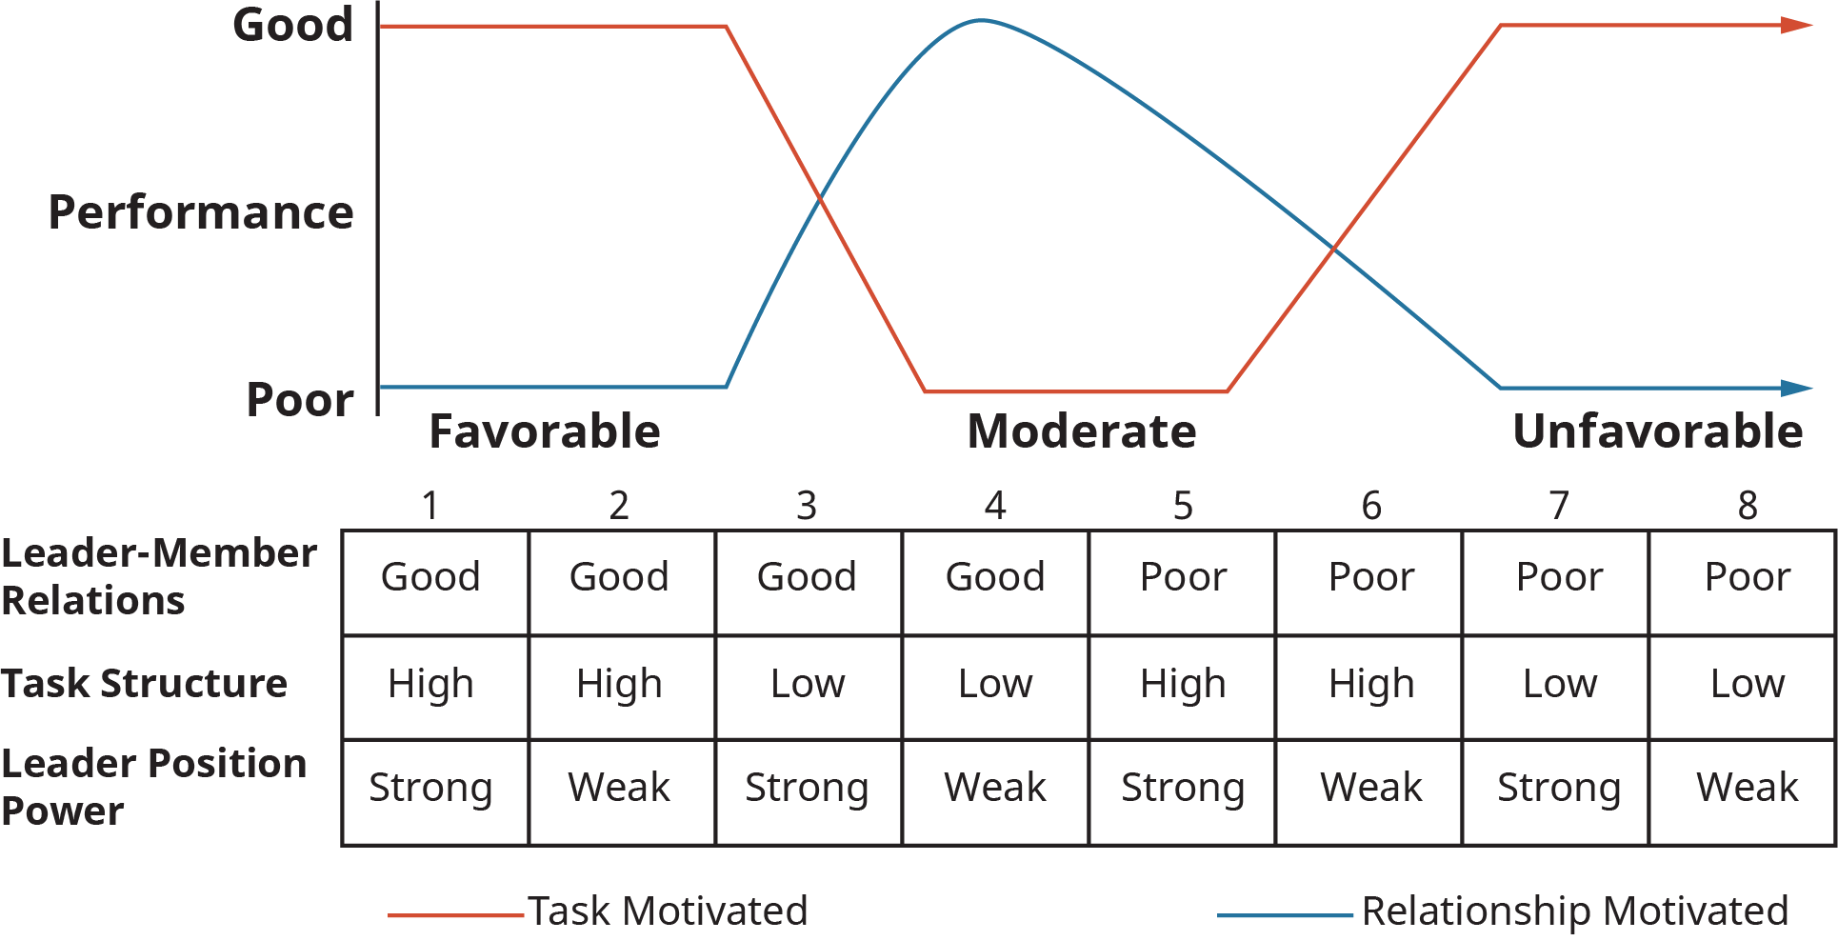
2nd Solution: Leadership Style
Leader with high LPC
Source: OpenStax

Slide 7
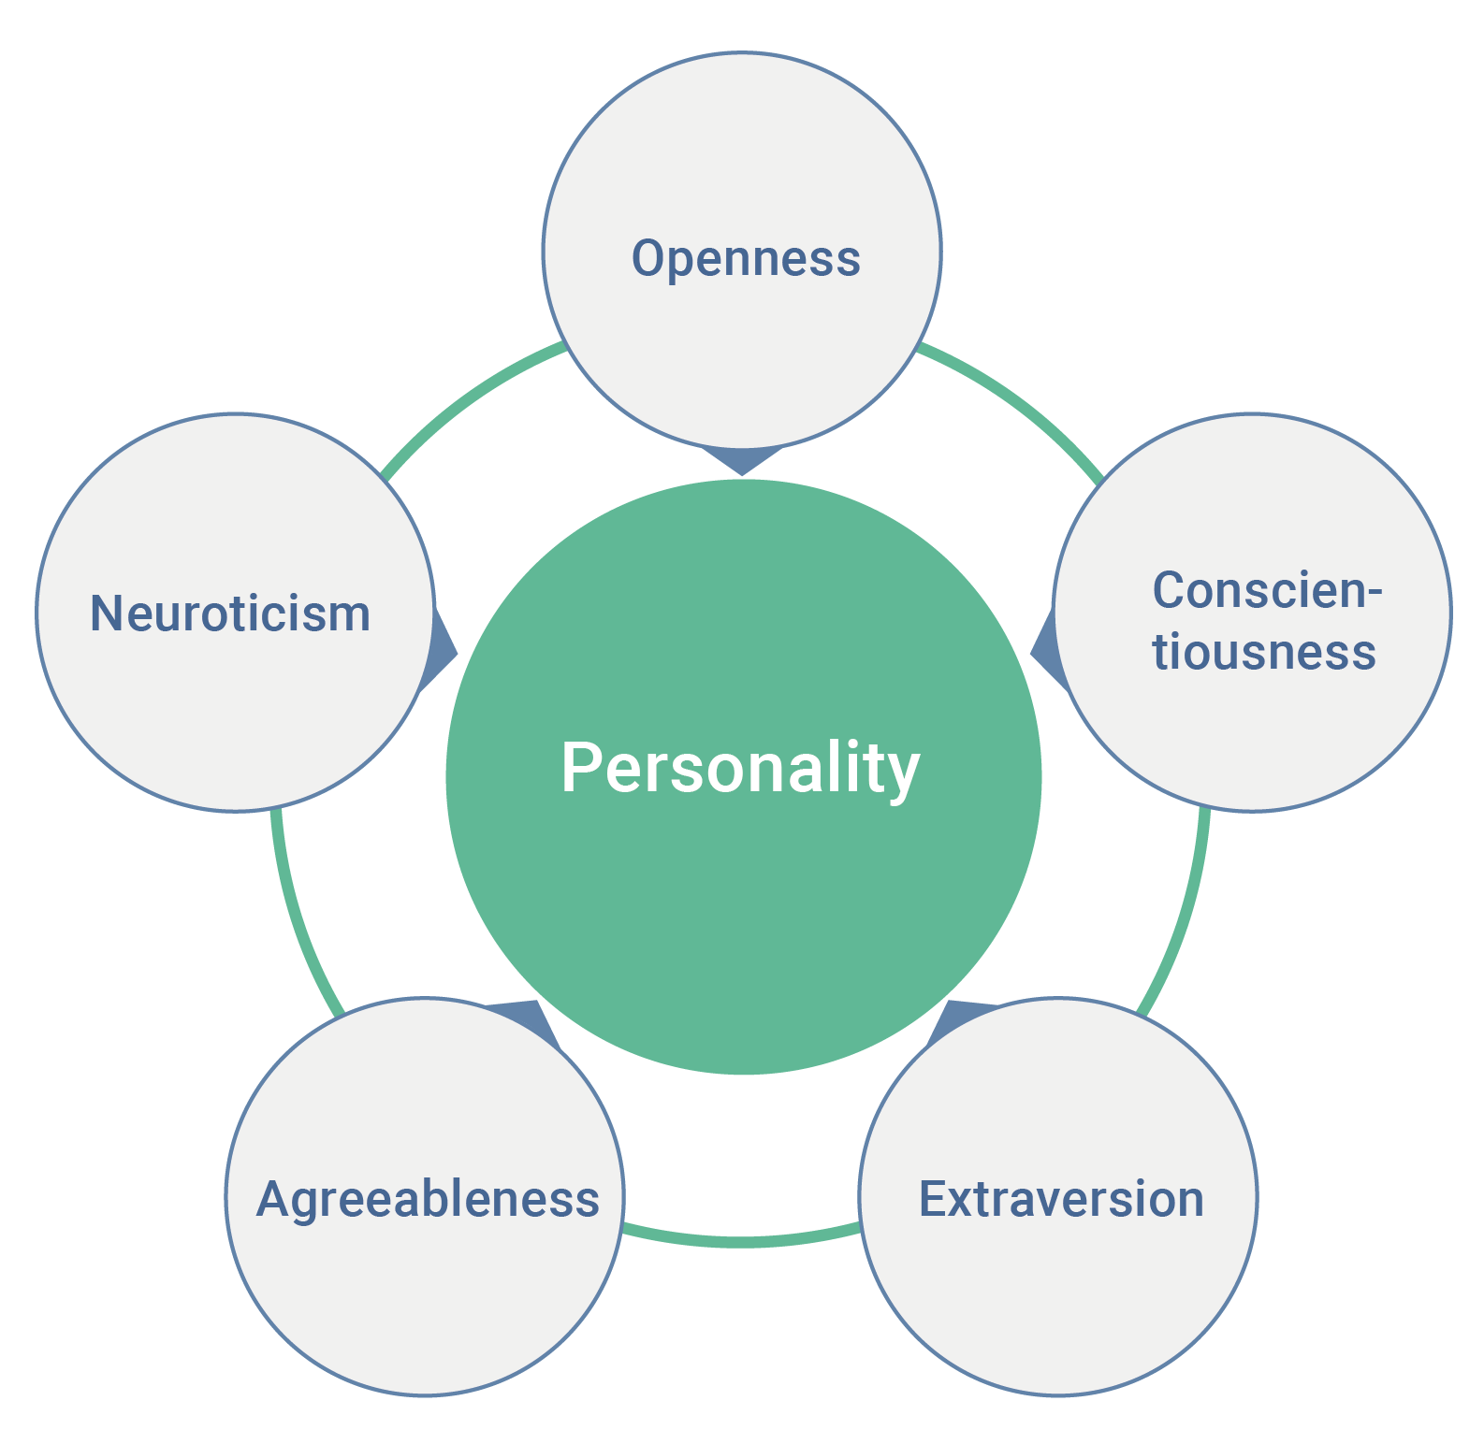
3rd Solution: Personality theories
Source: A. Tunikova, 2018

Slide 8
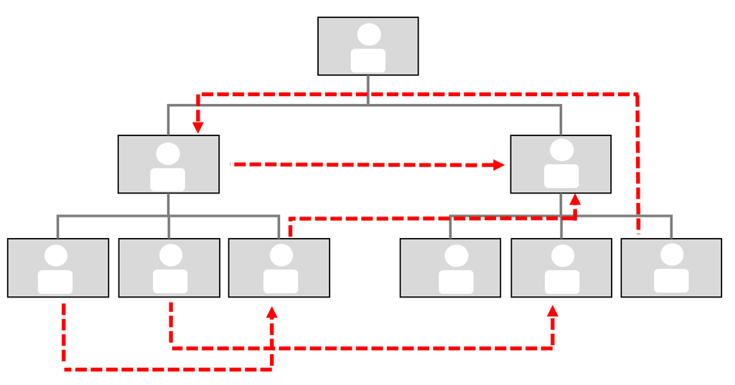
4th Solution: Organizational Structure
Matrix Structure
Source: N. Warren, 2017

Slide 9

Conclusion
Source: Commisceo Global, 2018
Understanding Culture
S. Cameron (2007) argues that Having respect for cultural differences and learning basic characteristics of other cultures can help you avoid misunderstandings and unintentionally offending others.

Slide 10
Reference
BIMCommunity. (2018). The Future of Construction: An European Overview [image]. Available from https://www.bimcommunity.com/news/load/631/the-future-of-construction-an-european-overview [Accessed 7 November 2020]
Cameron, S. (2000). Understanding Cultural Differences: Tips for Working with International Staff and Campers. American Camp Association. Available from https://www.acacamps.org/resource-library/camping-magazine/understanding-cultural-differences-tips-working-international-staff-campers [Accessed 7 November 2020]
Commisceo Global. (2018). Why is Cultural Awareness Important? [image] Available from https://www.commisceo-global.com/blog/why-is-cultural-awareness-important [Accessed 7 November 2020]

Slide 11
Gao, Y. et al. (2020). Exploring the Relationship between Construction Workers’ Personality Traits and Safety Behavior. Journal of Construction Engineering and Management. 146(3). Available from https://ascelibrary.org/doi/10.1061/%28ASCE%29CO.1943-7862.0001763 [Accessed 7 November 2020]
McLeod, S. (2020). Maslow's Hierarchy of Needs. Simplypsychology. Available from https://www.simplypsychology.org/maslow.html [Accessed 7 November 2020]
OpenStax. Situational (Contingency) Approaches to Leadership [image]. Available from https://opentextbc.ca/principlesofmanagementopenstax/chapter/situational-contingency-approaches-to-leadership/#ch13fig10 [Accessed 7 November 2020]

Slide 12
Pendrey, Ch. A guide to construction safety for homebuilders [image]. Available from https://www.build-review.com/a-guide-to-construction-safety-for-homebuilders/ [Accessed 7 November 2020]
Tunikova, A. (2018). The big five personality traits [image]. Available from https://en.wikipedia.org/wiki/Big_Five_personality_traits#/media/File:Wiki-grafik_peats-de_big_five_ENG.png [Accessed 7 November 2020]
Warren, A. (2017). The hidden matrix in your organization [image]. Available from https://www.organizationdesign.net/hidden-matrix-organization.html [Accessed 7 November 2020]

